Slide 1
Hosting and Deploying ASP.NET Core Application

Slide 2
Hosting: The service of providing the computer equipment and software for a website on the internet and making it available for people to see.
The process of installing an application into the server is called "Hosting”.
Once you successfully developed your web application, you are required to host the application to the web server so that other people can access it.
Deployment is the mechanism through which applications, modules, updates, and patches are delivered from developers to users.

Slide 3
Web Server
A web server is software and hardware that uses HTTP (Hypertext Transfer Protocol) and other protocols to respond to client requests made over the World Wide Web.
The web server usually receives incoming network HTTP requests and sends outgoing HTTP responses (one for each processed request), along with web contents, through transparent and / or encrypted TCP/IP connections (HTTPS).
Some of the web servers that can be used to host ASP.NET Core are:
IIS
Apache
NGINX

Slide 4
IIS
Internet Information Services (IIS, formerly Internet Information Server) is an extensible web server software created by Microsoft for use with the Windows operating systems. IIS supports HTTP, HTTP/2, HTTPS, FTP, FTPS, SMTP
It is one of the most powerful web servers from Microsoft that is used to host your ASP.NET Web application. IIS has its own ASP.NET Process Engine to handle the ASP.NET request. So, when a request comes from client to server, IIS takes that request and process it and send the response back to clients.
Advantages of IIS
The software is backed by Microsoft and is frequently patched and updated.
A huge advantage of IIS is that it integrates with other Microsoft offerings, specifically .NET and the ASPX scripting language

Slide 5
Apache Web Server
Apache HTTP Server is a free and open-source web server that delivers web content through the internet. It is commonly referred to as Apache and after development, it quickly became the most popular HTTP client on the web.It is developed and maintained by Apache Software Foundation. It runs over 60% of all webservers in the world. It is fast, reliable, and secure. It can be highly customized to meet the needs of many different environments by using extensions and modules.Apache is equally efficient on almost every operating system but finds can be found to be in maximum use when combined with Linux.
Advantages of Apache
Open-source and free, even for commercial use.
Reliable, stable software.
Frequently updated, regular security patches.
Flexible due to its module-based structure.
Easy to configure, beginner-friendly.
Cross-platform (works on multiple platform Linux, Unix and Windows servers).
Huge community and easily available support in case of any problem

Slide 6
NGINX Web Server
Nginx, pronounced like “engine-ex”, is an open-source web server that, since its initial success as a web server, is now also used as a reverse proxy, HTTP cache, and load balancer. It started out as a web server designed for maximum performance and stability.
Nginx is built to offer low memory usage and high concurrency. Rather than creating new processes for each web request, Nginx uses an asynchronous, event-driven approach where requests are handled in a single thread.
Advantages of Nginx
Opensource
Installations and configurations are simple and easy.
Fastest and the best for serving static files.
When compared to other web servers, four times more concurrent connections are handled

Slide 7
Kestrel
Whenever you create an ASP.NET Core application, by default it contains an internal server provided by a .NET Core that is called Kestrel. Due to this server, we can run ASP.NET Core apps on any platform like Windows, Mac or Linux. Before getting into the details about hosting models, let's first see what is the Kestrel server.
Kestrel is a cross-platform web server for ASP.NET Core. Kestrel is the webserver that's included by default in ASP.NET Core project templates.
Kestrel is based on the libuv library, the same library which is used by Node.
Some features of Kestrel:
It supports SSL
lightweight
cross-platform

Slide 8
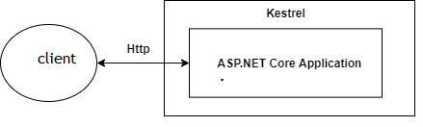
Hosting Models in ASP.NET Core
There are 2 types of hosting models in ASP.NET Core i.e In-process Hosting and Out-of-process Hosting. Before ASP.Net Core 2.2 we have only one hosting model which is Out-of-process but after due to the performance we have In Process Hosting Model in 2.2+ versions.
Out-of-process Hosting Model
In Out-of-process hosting models, we can either use the Kestrel server directly as a user request facing server or we can deploy the app into IIS which will act as a proxy server and sends requests to the internal Kestrel server. In this type of hosting model we have two options:
Using Kestrel
So in this type Kestrel itself acts as edge server which directly server user requests. It means that we can only use the Kestrel server for our application.

Slide 9
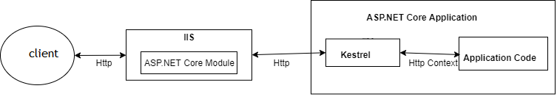
Using a Proxy Server
Due to limitations of the Kestrel server, we can not use this in all the apps. In such cases, we have to use powerful servers like IIS, NGINX or Apache. So, in that case, this server acts as a reserve proxy server which redirects every request to the internal Kestrel sever where our app is running. Here, two servers are running. One is IIS and another is Kestrel.
This model is a default model for all the applications implemented before .NET Core 2.2. But there are some of the limitations of using this type such as performance slowness

Slide 10
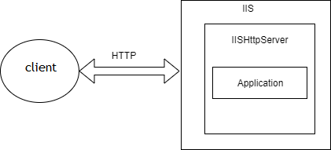
In-process Hosting Model
After the release of .NET Core 2.2, it introduced a new type of hosting which is called In-process hosting. In this type, only one server is used for hosting like IIS, Nginx or Linux. It means that the App is directly hosted inside of IIS. No Kestrel server is being used. IIS HTTP Server (IISHttpServer) is used instead of the Kestrel server to host apps in IIS directly. ASP.NET Core 3.1 onwards **In-process** hosting model is used as a default model whenever you create a new application using an existing template.

Slide 11
There are two ways to define the models:
In.csproj file
Open the .csproj file and add the below property to apply the proper hosting model.
<PropertyGroup>
<TargetFramework>netcoreapp3.1</TargetFramework>
<AspNetCoreHostingModel>OutOfProcess</AspNetCoreHostingModel>
</PropertyGroup>
So the value <AspNetCoreHostingModel> property is case insensitive and if we don't define this property then it by default consider as In-process hosting model

Slide 12
In web.config
In ASP.NET Core apps we don't have `web.config` so first, we have to publish the app and in the published folder you can see the `web.config` the file generated by ASP.NET Core. Now published the app you have created earlier and open the config file. It looks like this:
<?xml version="1.0" encoding="utf-8"?>
<configuration>
<location path="." inheritInChildApplications="false">
<system.webServer>
<handlers>
<add name="aspNetCore" path="*" verb="*" modules="AspNetCoreModuleV2" resourceType="Unspecified" />
</handlers>
<aspNetCore processPath="dotnet" arguments=".\DotNetCoreApp.dll" stdoutLogEnabled="false" stdoutLogFile=".\logs\stdout" hostingModel="inprocess" />
</system.webServer>
</location>
</configuration>
from ASP.NET Core 3.1, the **In-process** hosting model is the default model. So if you want to change it to other i.e. Out -of-process then you just need to change `hostingModel="OutOfProcess" `.

Slide 13
ASP.NET Core Module
The ASP.NET Core Module is a native IIS module that plugs into the IIS pipeline, allowing ASP.NET Core applications to work with IIS. Run ASP.NET Core apps with IIS by either:
Hosting an ASP.NET Core app inside of the IIS worker process (w3wp.exe), called the in-process hosting model.
Forwarding web requests to a backend ASP.NET Core app running the Kestrel server, called the out-of-process hosting model.
ASP.NET Core Module (ANCM) lets you run ASP.NET Core applications behind IIS and it works only with Kestrel; It sits in IIS and routes the request for ASP.NET Core application to Kestral.

Slide 14
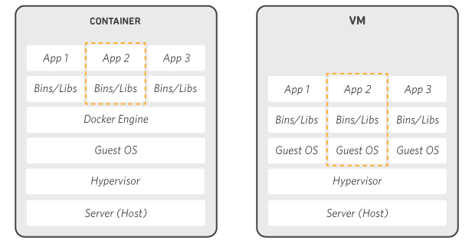
Docker And Containerization
Docker is a software platform that allows you to build, test, and deploy applications quickly. Docker packages software into standardized units called containers that have everything the software needs to run including libraries, system tools, code, and runtime. Using Docker, you can quickly deploy and scale applications into any environment and know your code will run. Docker works by providing a standard way to run your code. Docker is an operating system for containers. Similar to how a virtual machine virtualizes (removes the need to directly manage) server hardware, containers virtualize the operating system of a server. Docker is installed on each server and provides simple commands you can use to build, start, or stop containers.

Slide 15
.NET Core can easily run in a Docker container. Containers provide a lightweight way to isolate your application from the rest of the host system, sharing just the kernel, and using resources given to your application.
Docker basics
Images
An image is an ordered collection of filesystem changes that form the basis of a container. The image doesn't have a state and is read-only. Much the time an image is based on another image, but with some customization. For example, when you create an new image for your application, you would base it on an existing image that already contains the .NET Core runtime.
Containers
A container is a runnable instance of an image. As you build your image, you deploy your application and dependencies. Then, multiple containers can be instantiated, each isolated from one another. Each container instance has its own filesystem, memory, and network interface.

Slide 16
Registries
Container registries are a collection of image repositories. You can base your images on a registry image. You can create containers directly from an image in a registry. The relationship between Docker containers, images, and registries is an important concept when architecting and building containerized applications or microservices. This approach greatly shortens the time between development and deployment.
Docker has a public registry hosted at the Docker Hub that you can use. .NET Core related images are listed at the Docker Hub.
Dockerfile
A Dockerfile is a file that defines a set of instructions that creates an image. Each instruction in the Dockerfile creates a layer in the image. For the most part, when you rebuild the image, only the layers that have changed are rebuilt. The Dockerfile can be distributed to others and allows them to recreate a new image in the same manner you created it. While this allows you to distribute the instructions on how to create the image, the main way to distribute your image is to publish it to a registry.

Slide 17
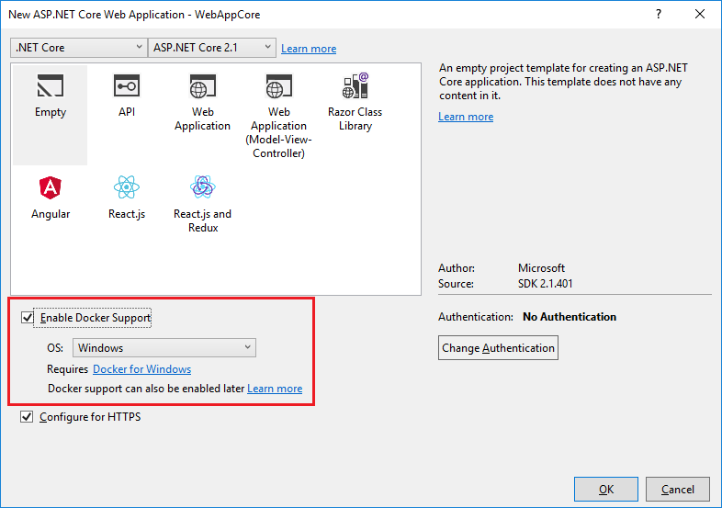

Slide 18
Publish to Azure Cloud
Microsoft Azure, commonly referred to as Azure, is a cloud computing service created by Microsoft for building, testing, deploying, and managing applications and services through Microsoft-managed data centers. It provides software as a service (SaaS), platform as a service (PaaS) and infrastructure as a service (IaaS) and supports many different programming languages, tools, and frameworks, including both Microsoft-specific and third-party software.
Azure consists of numerous service offerings, its use cases are extremely diverse. Running virtual machines or containers in the cloud is one of the most popular uses for Microsoft Azure. These compute resources can host infrastructure components, such as domain name system (DNS) servers; Windows Server services -- such as Internet Information Services (IIS); or third-party applications. Microsoft also supports the use of third-party operating systems, such as Linux.e and systems.

Slide 19
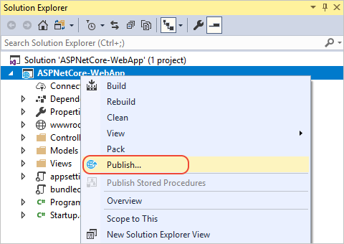
1) In Solution Explorer, right-click the project node and choose Publish (or use the Build > Publish menu item).

Slide 20
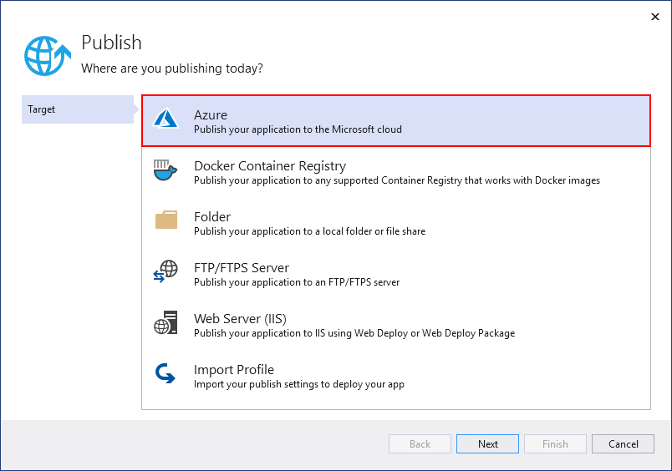
2) If you have previously configured any publishing profiles, the Publish window appears. Select New.
3) In the Publish window, select Azure.

Slide 21
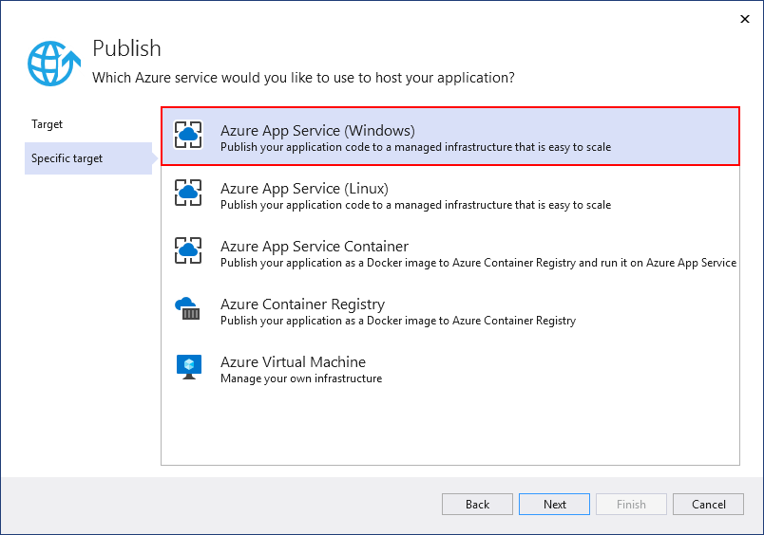
4) Select Azure App Service (Windows) and Next.

Slide 22
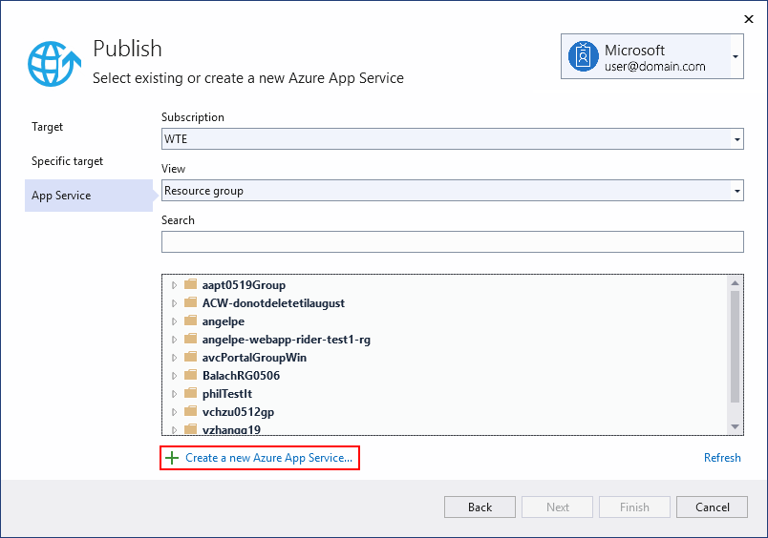
5) Sign in with your Azure account, if necessary. Select Create a new Azure App Service...

Slide 23
6) In the Create Azure App Service (Windows) dialog, the App Name, Resource Group, and App Service Plan entry fields are populated. You can keep these names or change them. When ready, select Create.
7) In the Publish dialog, the newly created instance has been automatically selected. When ready, select Finish.
8) Select Publish. Visual Studio deploys the app to your Azure App Service, and the web app loads in your browser. The project properties Publish pane shows the site URL and other details.

Slide 24
